Slide 1
Land change in Guam from 2006 to 2020
Vanchy Li, Mina Wei

Slide 2
Introduction
This study is about land change in Guam
Land conservation is an essential action, as unjustified land development can lead to soil erosion, which can harm the local environment.
Focusing on past land change will allow us to better predict and plan for future land use.
Our study will compare Guam in 2006, 2014, and 2022, and analyze the land change in Guam by comparing maps.

Slide 3
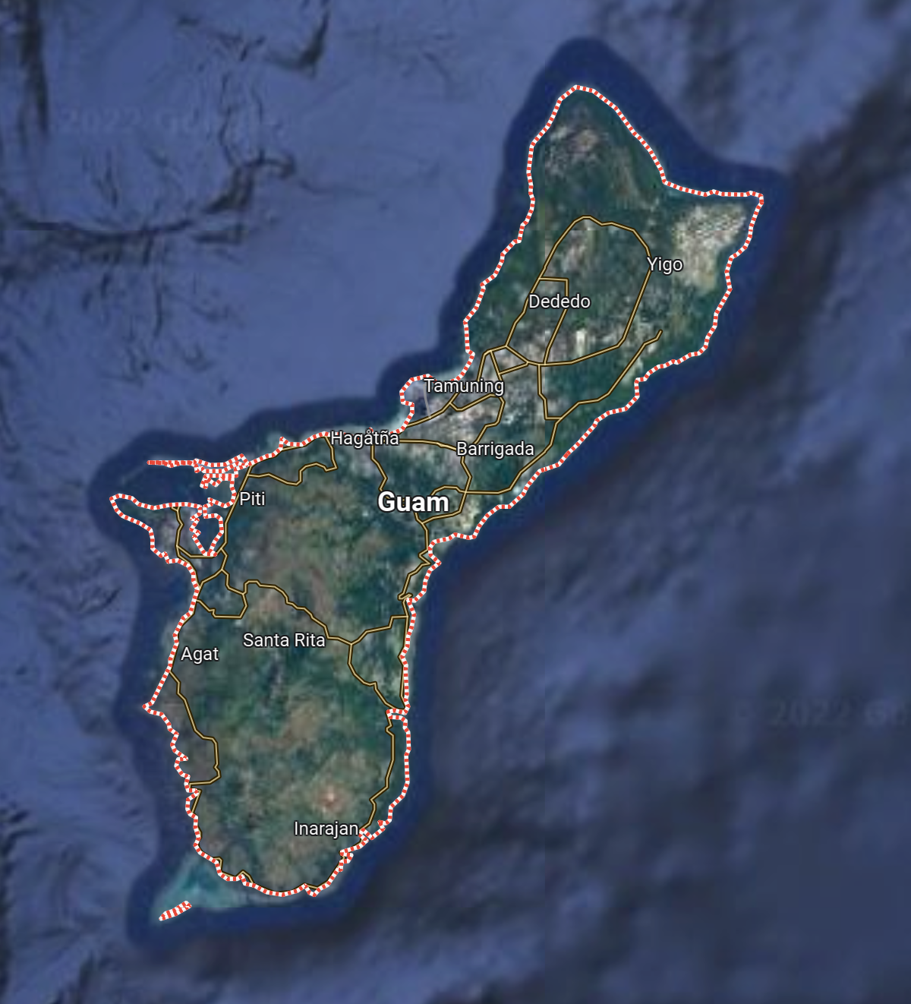
Study Area
Guam is an unincorporated territory of the United States in the Western Pacific Ocean
It has an area of 540 square kilometers and a population of 168,801
Guam exploits its natural resources on an ocean basis for economic gain
Because of its location and size, Guam is particularly sensitive to climate change

Slide 4
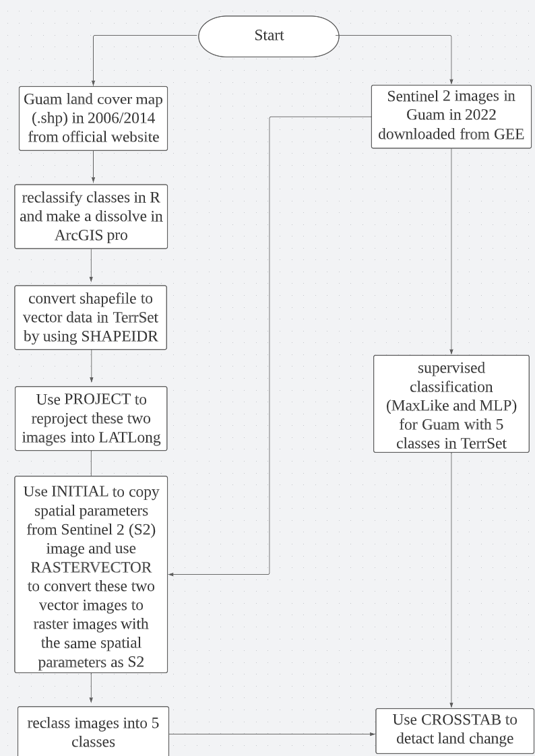
Data and Methods
Land change data in 2006 and 2014 from USDA
Sentinel 2 images and the boundary of Guam in 2022 from Google Earth Engine (GEE) (script link)

Slide 5
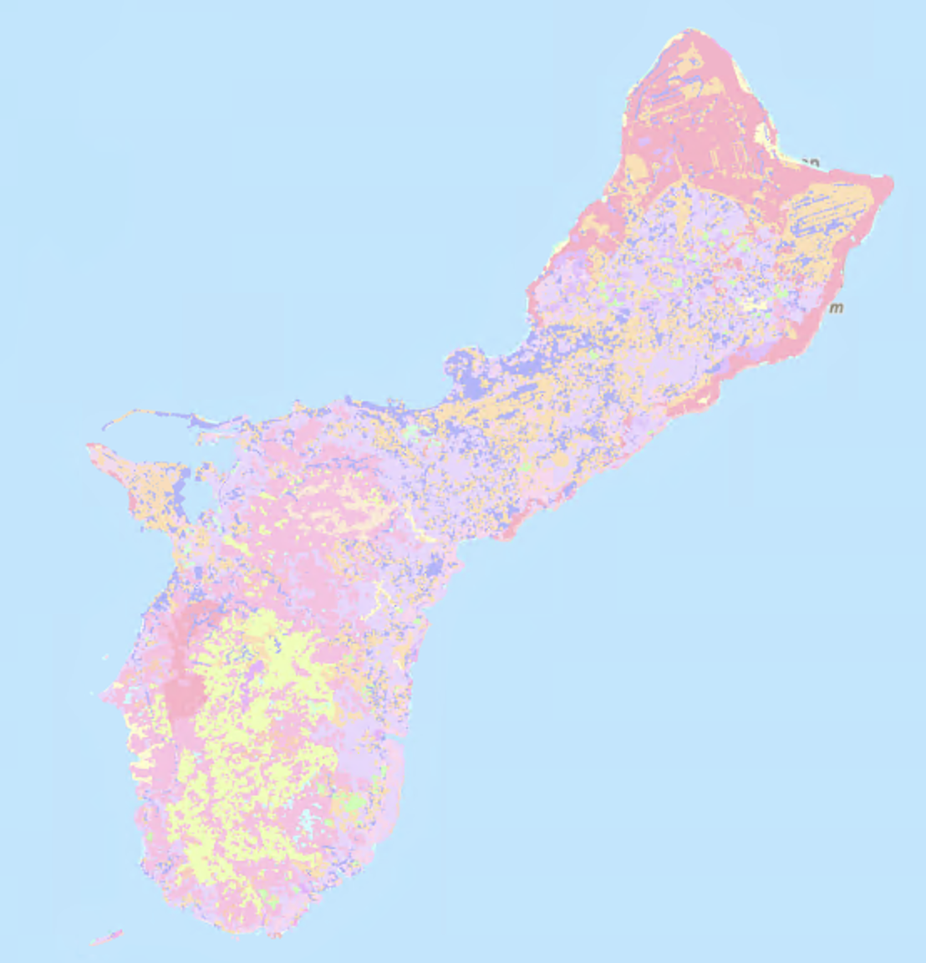
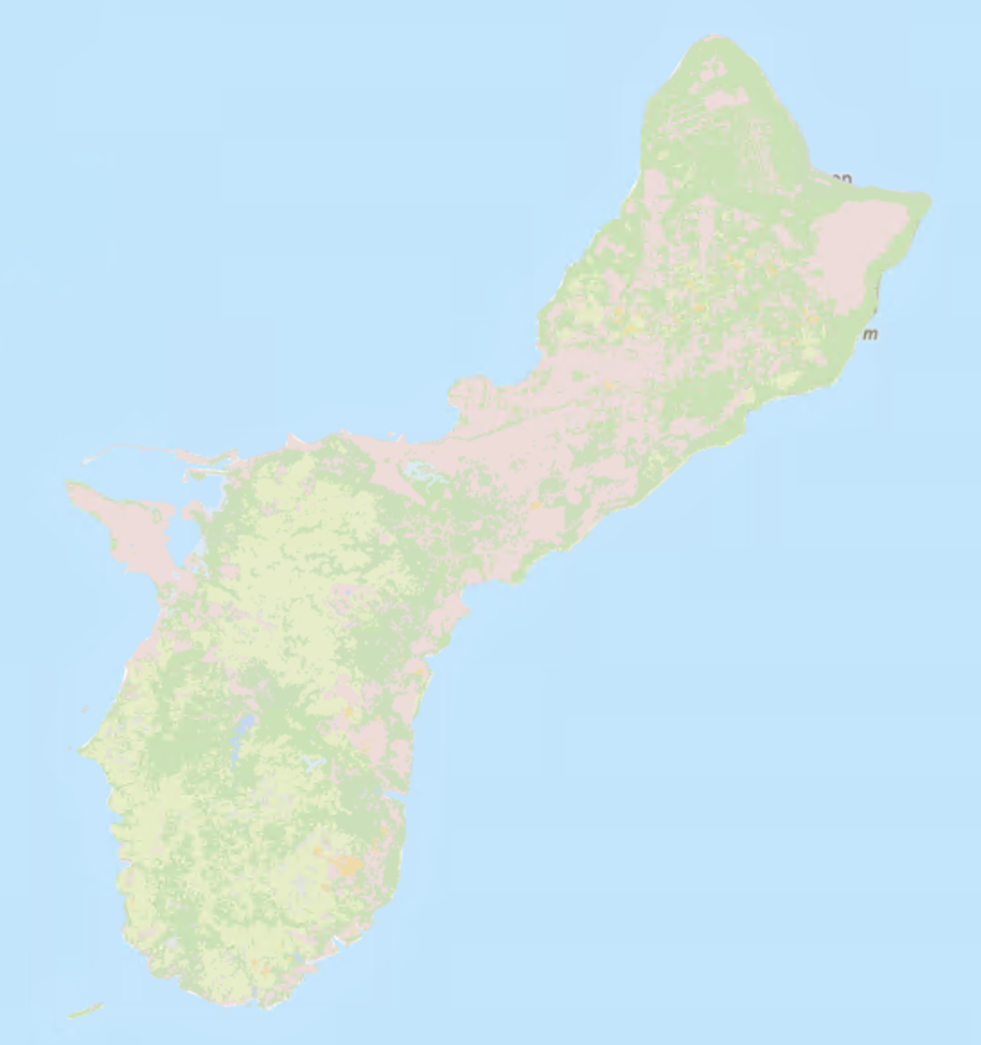
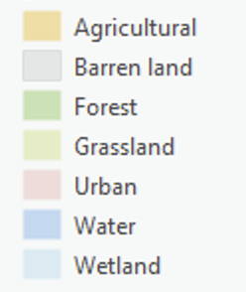
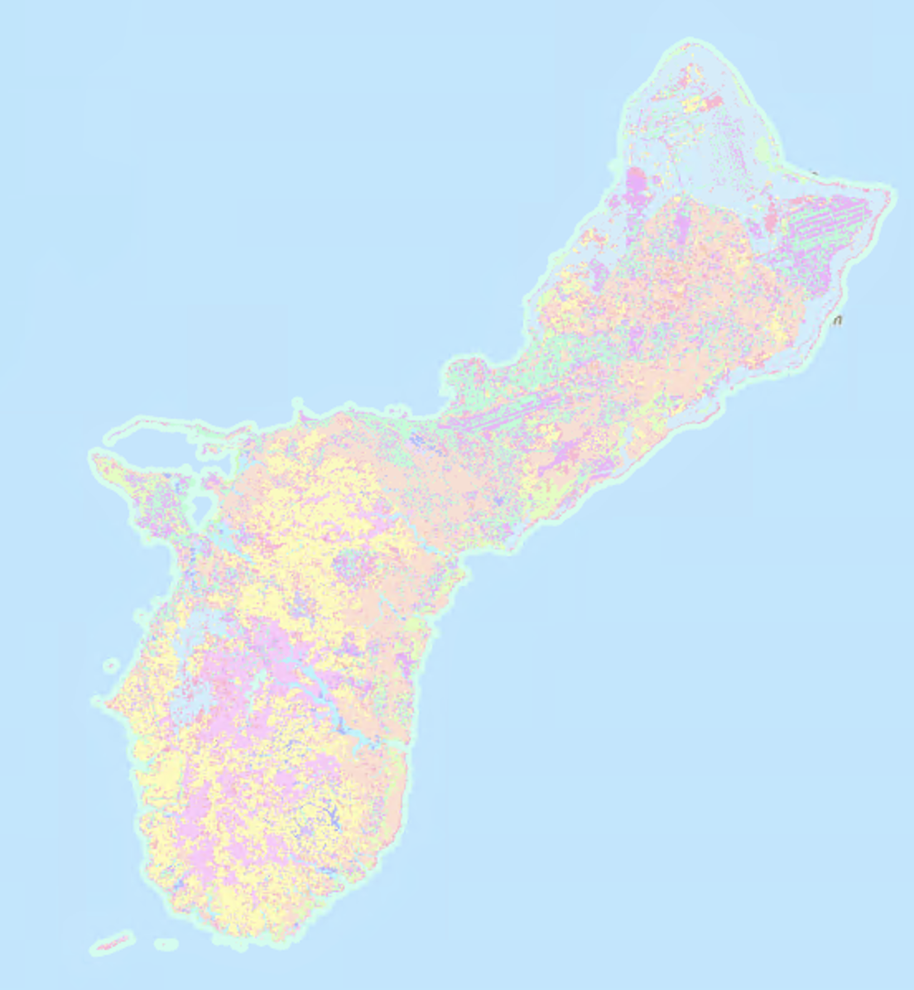
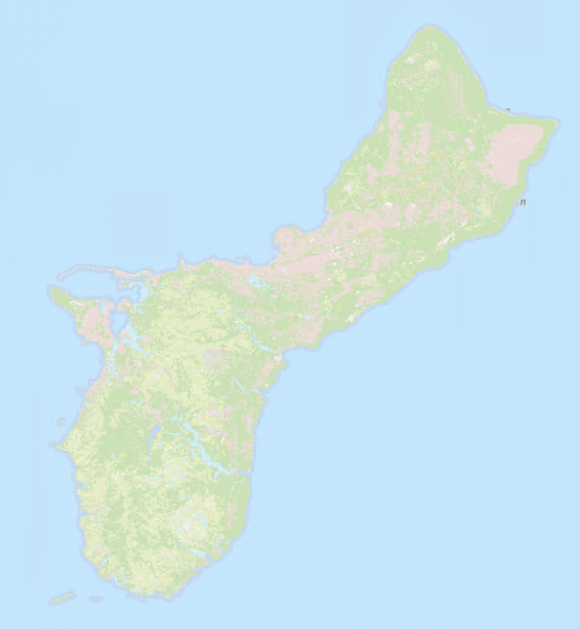
reclassify 21 to 7classes and dissolve
preprocessing in R and ArcGIS Pro
2006 original Guam data
Data after reclass and dissolve (2006)
reclassify 17 to 7 classes and dissolve
Data after reclass and dissolve (2014)
2014 original Guam data
Notes:
preprocessing in R and ArcGIS Pro

Slide 6
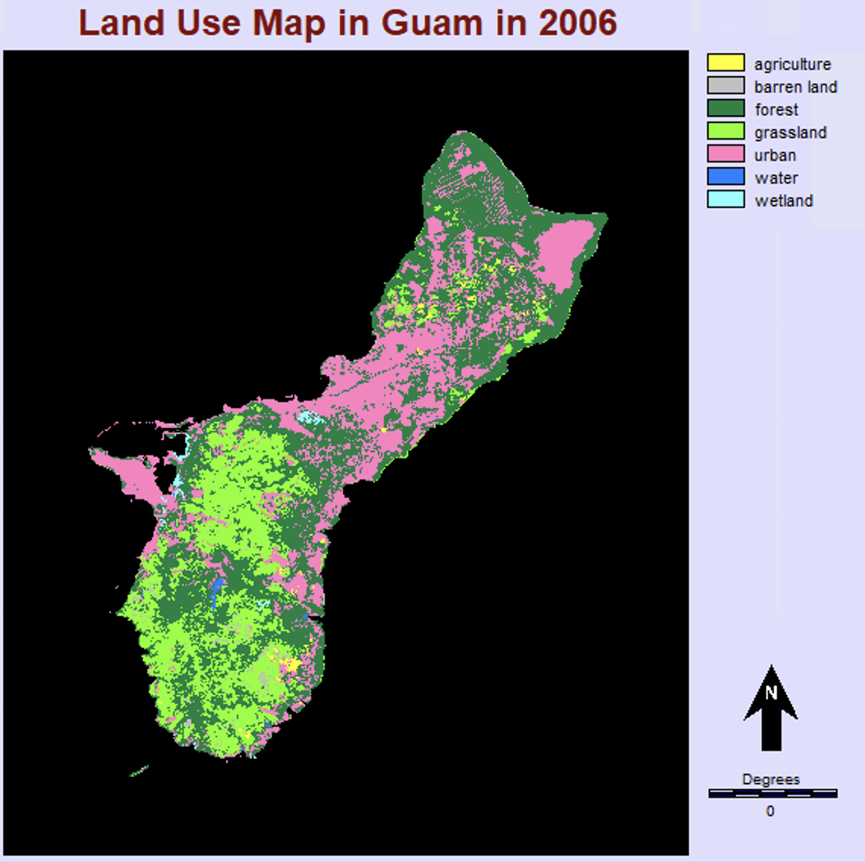
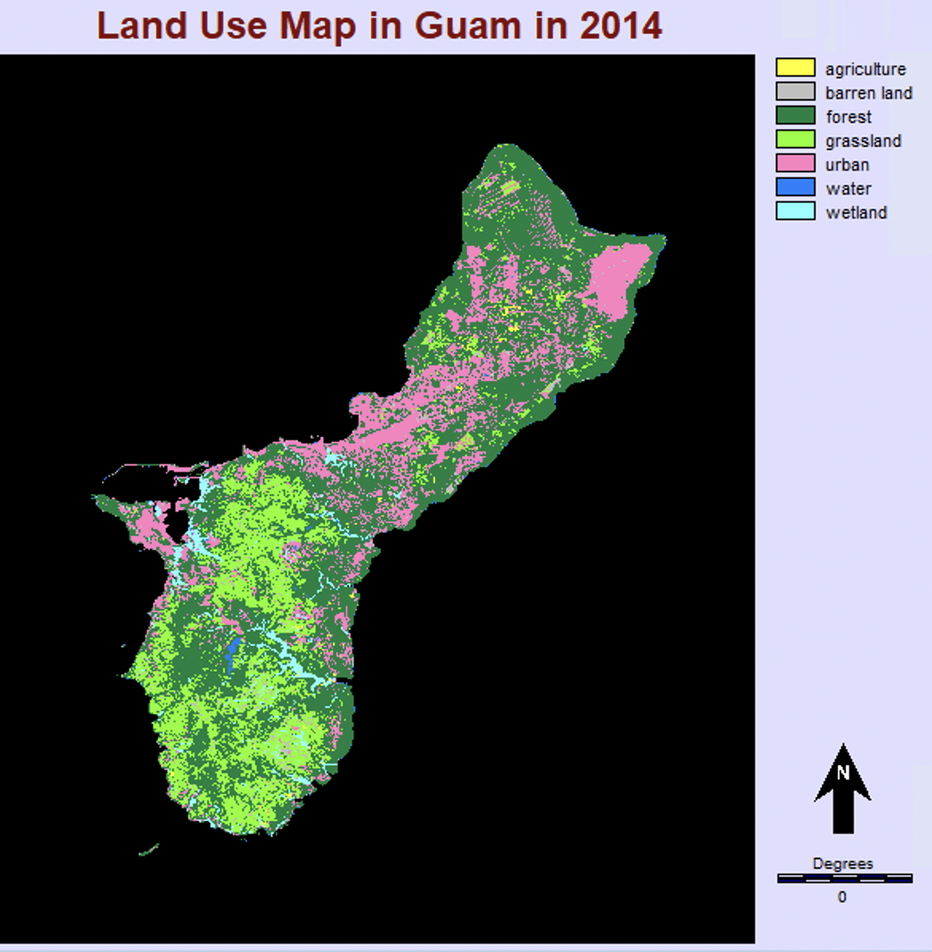
Preprocessing and results in TerrSet
In TerrSet, these two images were preprocessed as following: converted into vector data, reprojected, and clipped to a identical size.

Slide 7
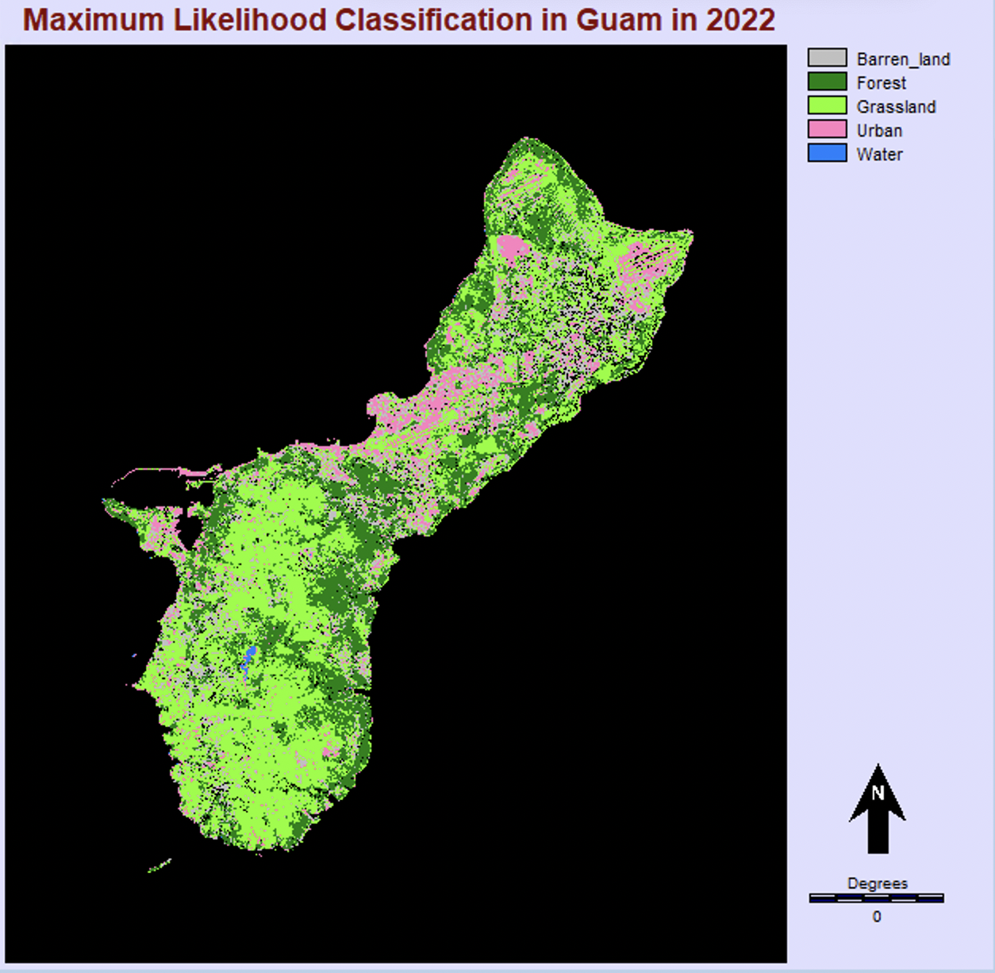

Results: Supervised Classicification in Guam, 2022
Here is the classification results in 2022 by using MaxLike and MLP functions in TerrSet.

Slide 8
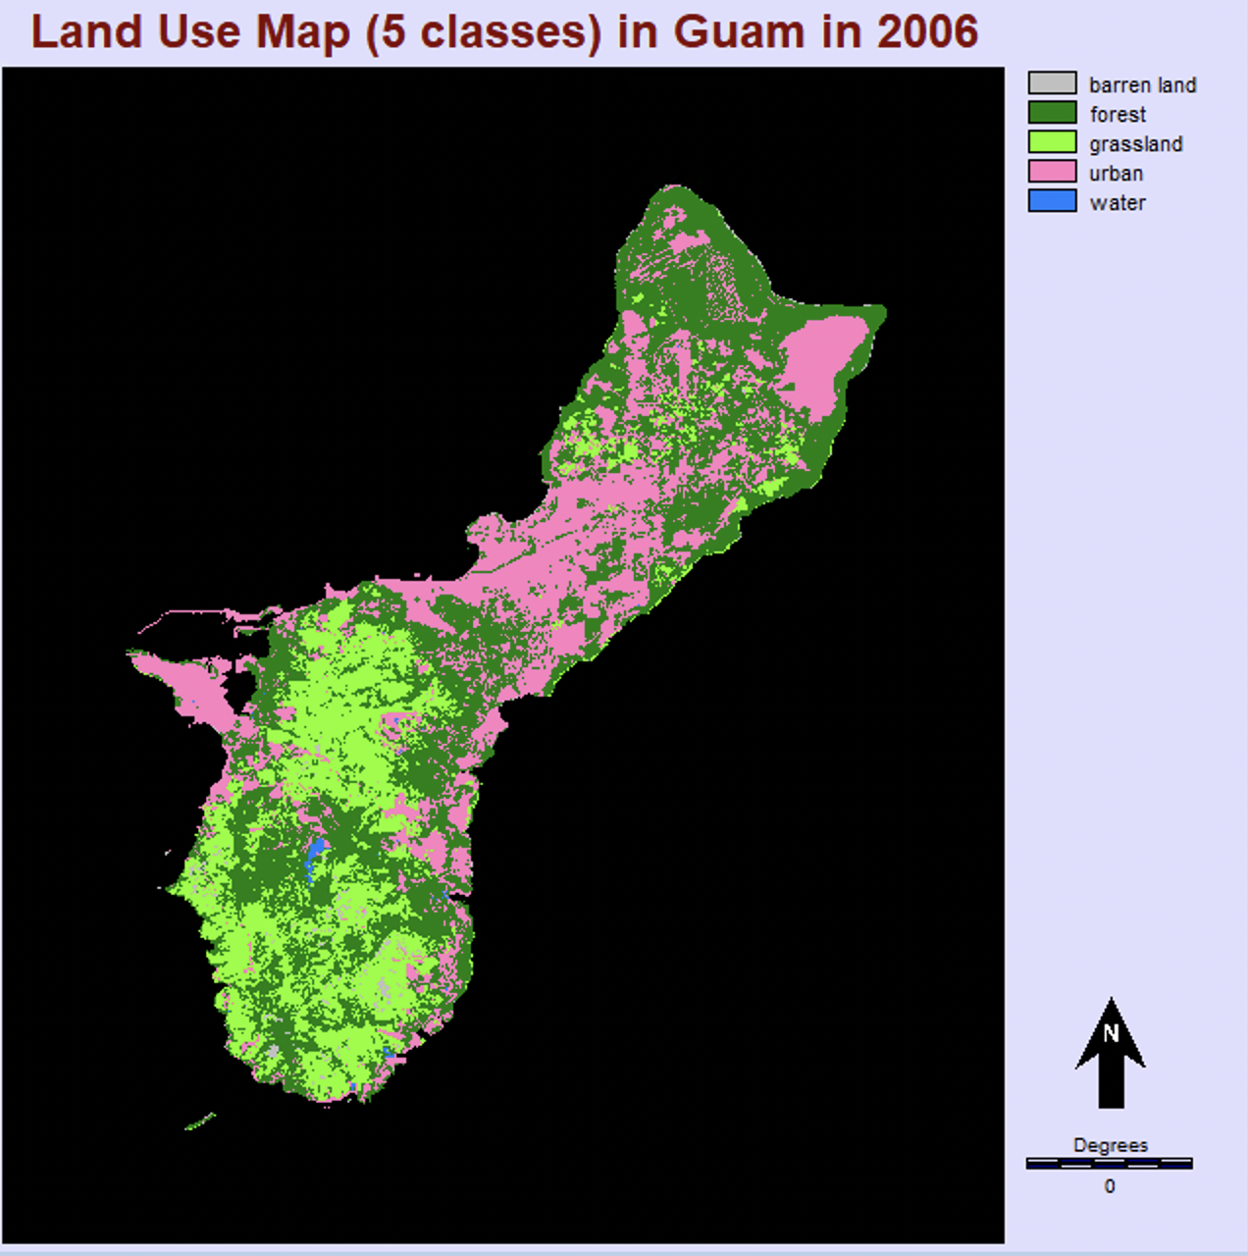
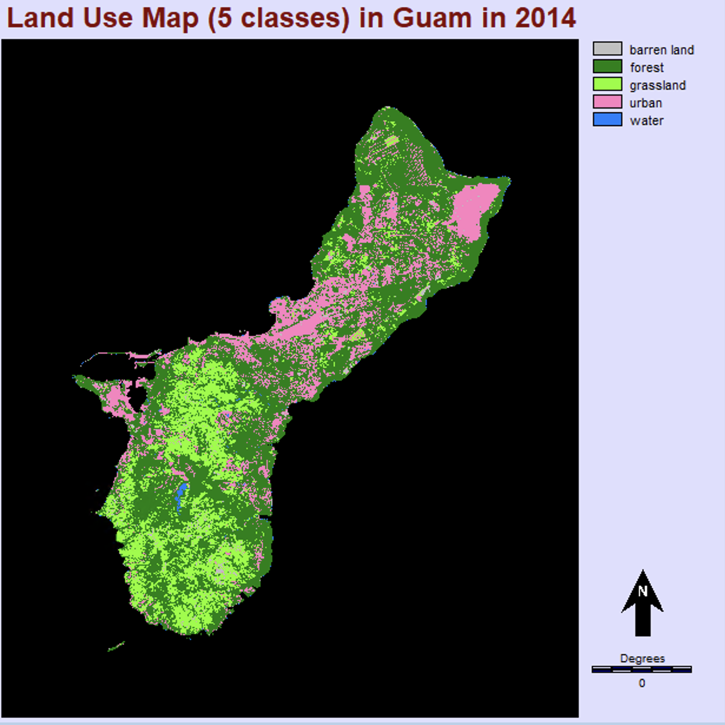
Map Comparasion from 2006 to 2022
Decrease in commercial land and urbanized areas
Decrease in forests and increase in grassland
Possible causes: different classification methods of classifiers, man-made fire causes, newly implemented conservation policies
Notes:
可能的原因

Slide 9
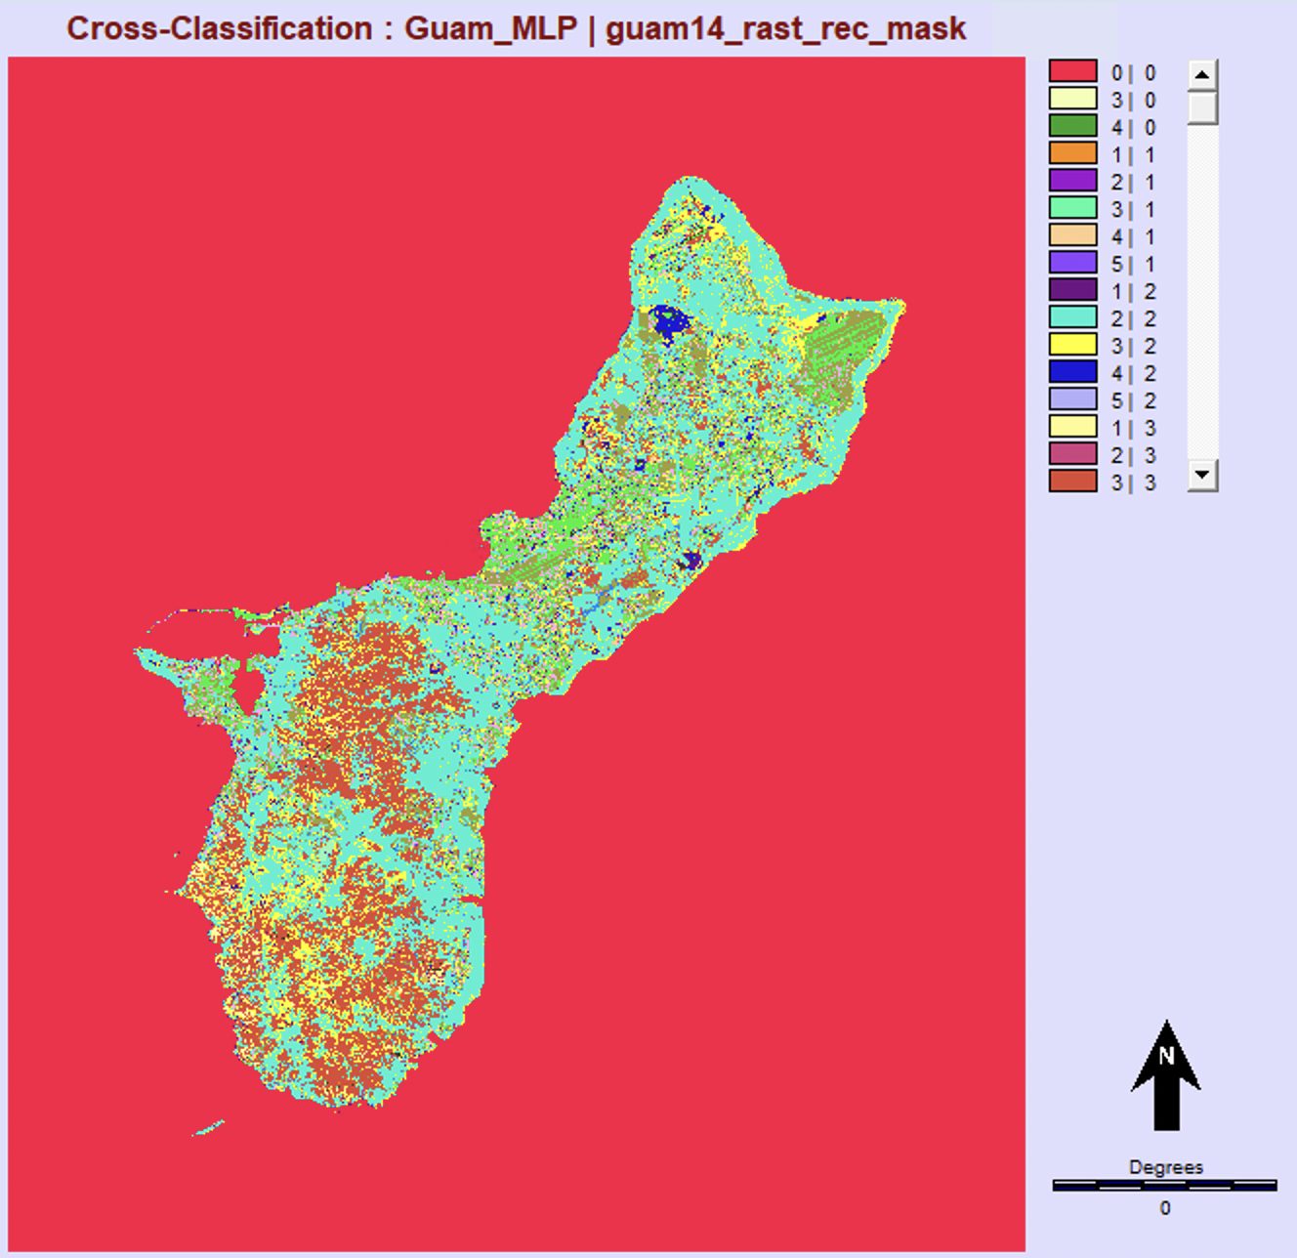
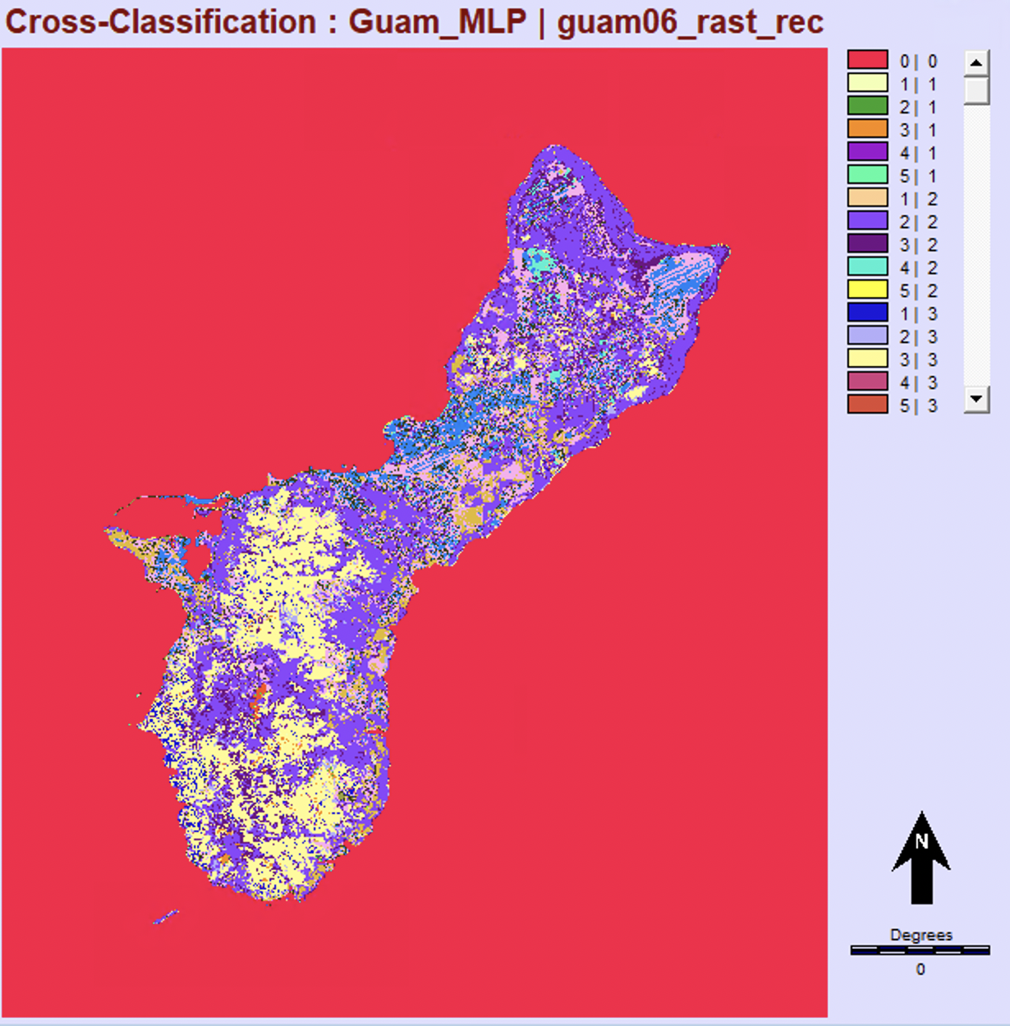
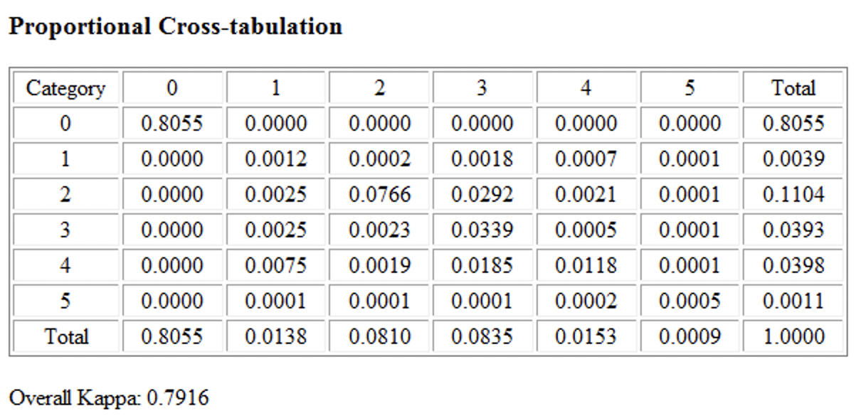
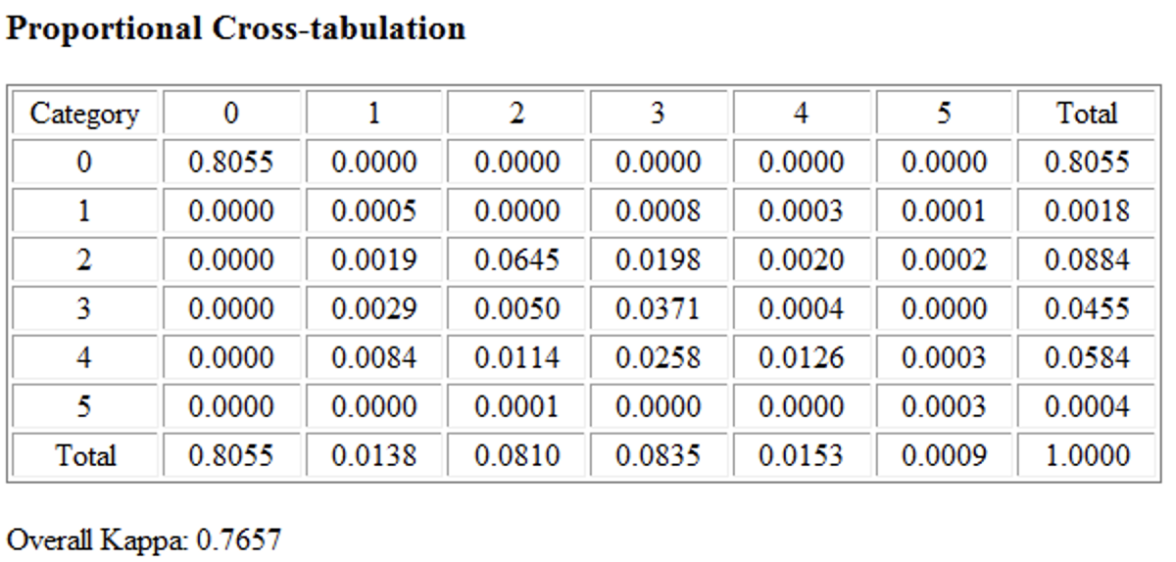
Cross-Tabulation
From the cross-table,
in 2022, the proportion of each class is 7.09% (barren land), 41.65% (forest), 42.93% (grassland), 7.87% (urban), and 0.46% (water);
in 2014, the proportion is 2.01% of barren land, 56.26% of forest, 20.21% of grassland, 20.46% of urban, and 0.56% of water;
in 2006, the proportion is 0.93%, 45.45%, 23.39%, 30.02%, and 0.21% respectively.
0: Background; 1: Barren land; 2: Forest; 3: Grassland; 4: Urban; 5: Water

Slide 10
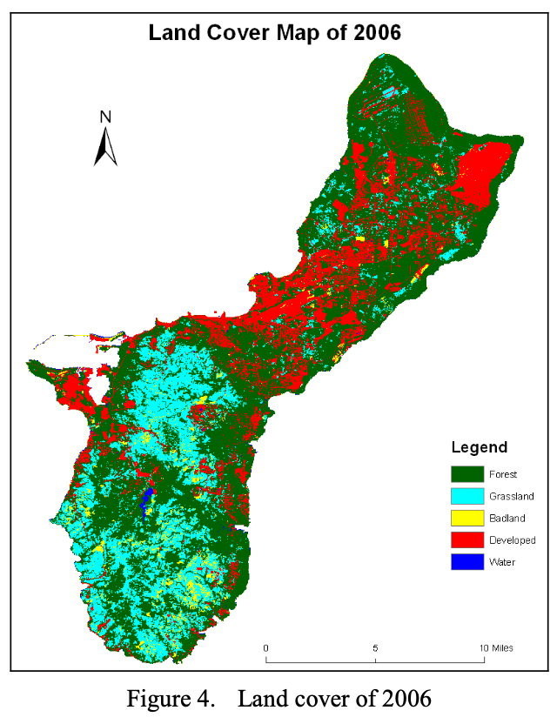
Discussion

Slide 11
Conclution
Our method can separate urban land from non-urban land (e.g., vegetation) in a more detailed way, which can improve the classification accuracy.
We found that bare land and grassland improved a lot compared to the data of 2006 and 2014. Some news in Guam reported that though Guam has abundant rainfall all year around, many forest fire happened each year, so it is suspected that those wildfires were caused by humans. Thus, hold the point that the increase of barren land and grassland was due to bad land and regrow vegetation after the wildfire.
However, we also admit that our classification method is not accurate enough that would also cause misclassification or inaccurate classification and lead to less precise subsequent analysis.

Slide 12
Reference
Wen, Y. (2011). Data application of multi-temporal and multi-source data for land cover change detection in Guam, USA. 2011 19th International Conference on Geoinformatics. doi:10.1109/geoinformatics.2011.5981058
Timothy A. Warner, David J. Campagna, Florencia Sangermano. (2020) remote sensing with terrset 2020®/idrisi® a beginner’s guide

Slide 13
Thank you!

